Slide 1
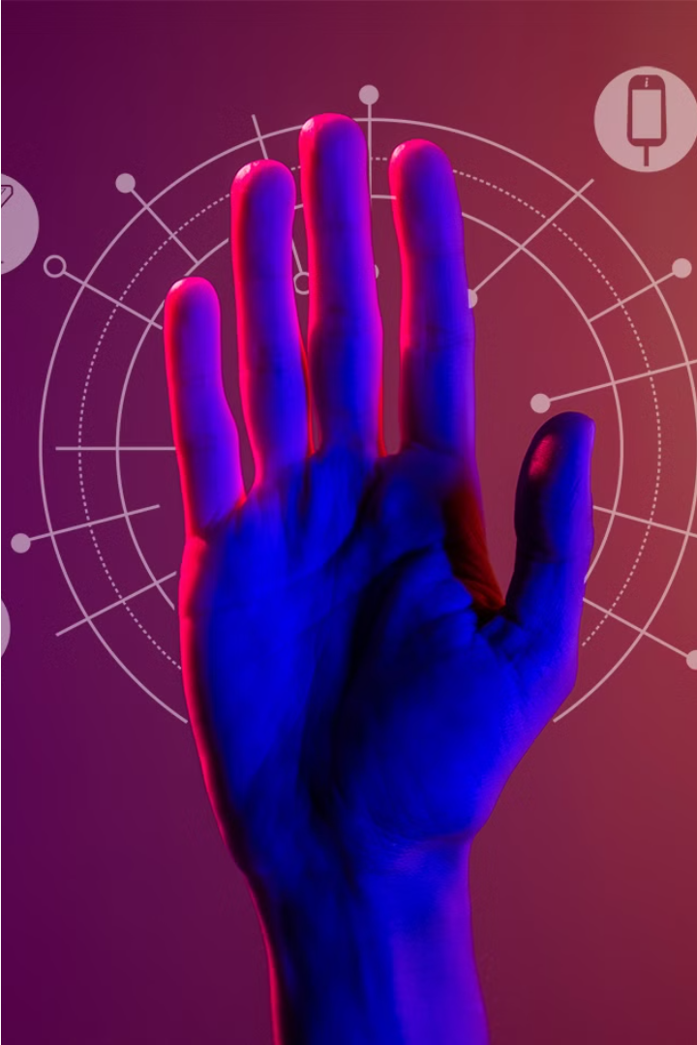
Gesture Recognition System: Empowering Communication
Group Members-
Vipul Joseph Pinto (20201CSE0596)
Hemanth Kumar Shetty M(20201CSE0655)
Deepak V (20201CSE0673)
Da

Slide 2
Introduction
Communication lies at the heart of human experience, shaping our interactions, relationships, and sense of belonging. For individuals with speech impairments, however, the ability to communicate effectively can be elusive, leading to feelings of frustration, isolation, and disconnection. GestureSense seeks to address this fundamental need by providing a revolutionary platform that enables users to communicate through hand gestures.
By leveraging the latest advancements in gesture recognition technology, GestureSense opens doors to a world where every gesture is understood, every movement meaningful. This introduction sets the stage for a comprehensive exploration of GestureSense, from its inception to its potential to transform the lives of its users.

Slide 3

Objectives: Empowering Communication through Gesture
1
Robust Gesture Recognition
2
Intuitive User Experience
Develop a hand gesture recognition system capable of accurately interpreting a diverse range of gestures in real-time, ensuring inclusivity and accessibility for users across varying contexts and environments.
Design an intuitive and user-friendly interface that invites users to engage with GestureSense with ease and confidence, fostering a sense of empowerment and agency.
4
Personalization and Expansion
3
Continuous Improvement
Explore opportunities for customization and personalization within GestureSense, allowing users to tailor the system to their unique communication styles and preferences.
Conduct thorough testing and evaluation to ensure that GestureSense meets the diverse needs and preferences of its users, fostering a culture of continuous improvement and innovation.

Slide 4
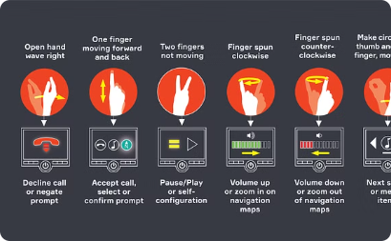
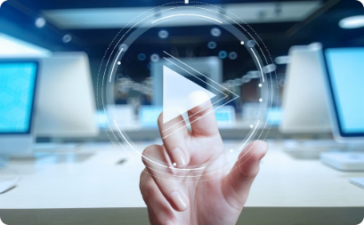
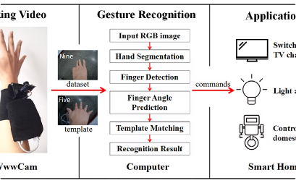
GestureSense: Bridging the Communication Gap
Seamless Integration
Intuitive Interaction
Robust Architecture
GestureSense's design embodies a synthesis of technological innovation, user-centered principles, and human-computer interaction considerations, ensuring seamless integration of hardware and software components.
The user interface of GestureSense serves as a window into the system's capabilities, inviting users to explore a world where every gesture is a message and every message is a connection.
The system architecture of GestureSense is meticulously crafted to facilitate the seamless integration of hand tracking, gesture recognition, and message generation, delivering a comprehensive and reliable solution.

Slide 5
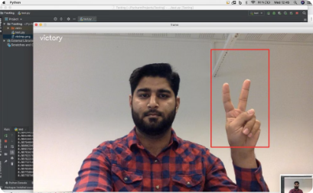
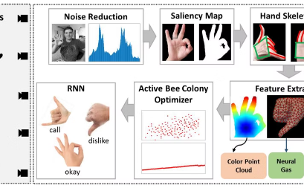
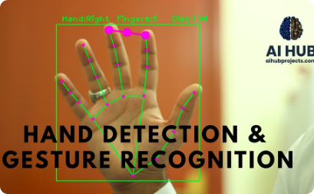
Gesture Recognition in Action
Real-Time Gesture Tracking
Intuitive User Interface
Diverse Application Potential
The GestureLink interface is designed with user-friendliness in mind, offering an intuitive and visually appealing experience that encourages users to engage with the system with confidence and ease.
GestureLink's advanced hand tracking capabilities enable the system to accurately detect and interpret a wide range of hand gestures in real-time, ensuring seamless and responsive communication for users.
GestureLink's versatility extends beyond the realm of assistive technology, with the potential to be integrated into a wide range of applications, from virtual reality experiences to smart home controls, further expanding the reach and impact of this innovative technology.

Slide 6
Challenges and Innovations in Gesture Recognition
Orientation Histogram
Fuzzy C-Means Clustering
Orientation histogram methods can face challenges, as similar gestures may have different histograms, and different gestures could have similar histograms, potentially leading to misclassification.
Fuzzy C-Means clustering algorithms can struggle with issues like wrong object extraction, performance degradation at larger distances, and sensitivity to lighting conditions and unwanted object overlap.
1
2
3
Neural Networks
While neural networks have been effective in gesture classification, they can be computationally intensive, especially as the number of training data increases, leading to longer processing times.

Slide 7




GestureSense: Empowering Communication, Transforming Lives
Hand Tracking
Machine Learning
Intuitive Interface
Effective Communication
MediaPipe's hand tracking module captures the essence of hand movements, providing the foundation for accurate gesture recognition.
TensorFlow's powerful machine learning models bring the recognized gestures to life with unparalleled accuracy and precision.
The user-centric design of GestureSense's interface invites users to explore a world where every gesture is a message.
GestureSense empowers individuals with speech impairments to communicate effortlessly, fostering connection and understanding.

Slide 8



Methodology
Requirements
1
Hand gesture input
Hardware
2
Web Cam
Software
3
Mediapipe, TensorFlow, Python
The methodology section outlines the systematic approach taken in the design, development, and testing of GestureSense, encompassing a series of interconnected stages and activities aimed at achieving project objectives. Beginning with a deep dive into user requirements and a review of existing research, the methodology progresses through iterative cycles of design, prototyping, and testing. Python serves as the canvas upon which GestureSense is painted, while MediaPipe and TensorFlow provide the colors that bring it to life. Through a relentless pursuit of excellence and a commitment to user feedback, GestureSense emerges as a testament to the power of human-centered design in shaping technology for the better.

Slide 9
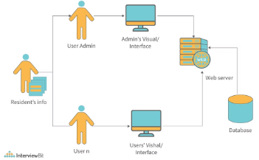
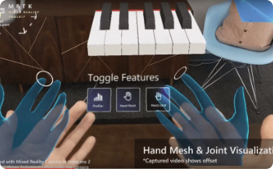
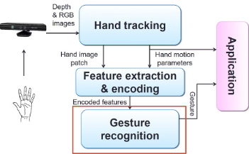
System Architecture
Seamless Integration
Cutting-Edge Tracking
Elegant Design
GestureSense's design embodies a synthesis of technological innovation, user-centered design principles, and human-computer interaction considerations, with a focus on maximizing functionality, usability, and accessibility. The system architecture is meticulously crafted to facilitate seamless integration of hardware and software components, with each element playing a vital role in the gesture recognition process.
MediaPipe's hand tracking module captures the essence of hand movements, while TensorFlow's machine learning models bring them to life with unparalleled accuracy and precision. The user interface serves as a window into GestureSense's soul, inviting users to explore a world where every gesture is a message, and every message is a connection.
At the heart of GestureSense lies a design philosophy rooted in simplicity, accessibility, and elegance. The system architecture is carefully crafted to ensure seamless integration of hardware and software components, with each element playing a vital role in the gesture recognition process.

Slide 10
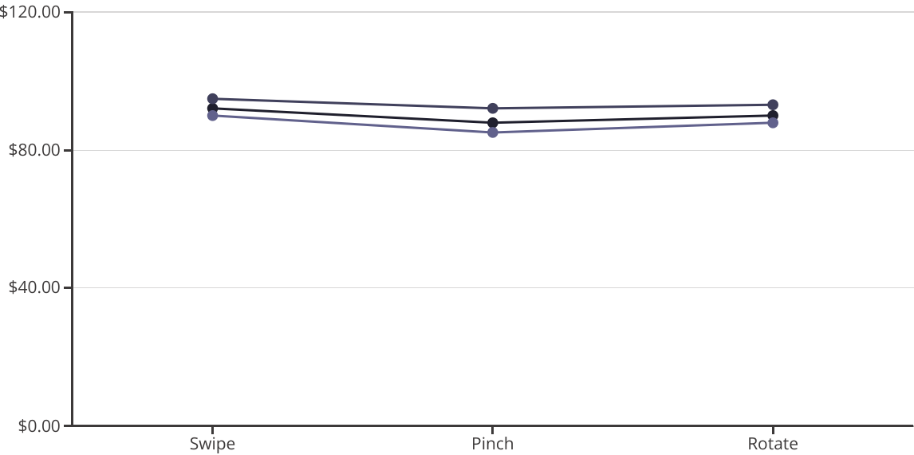
Evaluation and Results
Accuracy
Precision
Recall
The evaluation results demonstrate that the GestureSense system effectively processes and classifies hand gestures with high accuracy, precision, and recall. The line chart presents the performance metrics for the key gestures of swipe, pinch, and rotate, showcasing the system's reliability in enabling communication for users with speech impairments.

Slide 11
Conclusion
As GestureSense embarks on the final leg of its journey, it stands tall as a beacon of human compassion and technological prowess in the landscape of assistive technology. Each line of code, each meticulously crafted algorithm, is a testament to the unwavering dedication and empathy of the team behind it. With every gesture it recognizes, GestureSense extends a lifeline to those whose voices are often lost in the cacophony of the world.
In the symphony of human connection, GestureSense orchestrates a melody of understanding and belonging for individuals with speech impairments. It transforms mere movements into profound messages, bridging the gap between silence and expression with grace and precision. As we bid adieu to this chapter of our journey, we do so with hearts brimming with gratitude and eyes shimmering with the hope of a brighter future.
For in the tapestry of human experience, GestureSense is more than just a technological marvel—it is a testament to the boundless capacity of the human spirit to innovate, to empathize, and to uplift. And as it continues to illuminate the path forward, we stand in awe of its legacy, knowing that it will forever shape the landscape of assistive technology and redefine the way we connect, communicate, and understand each other.

